Slide 1
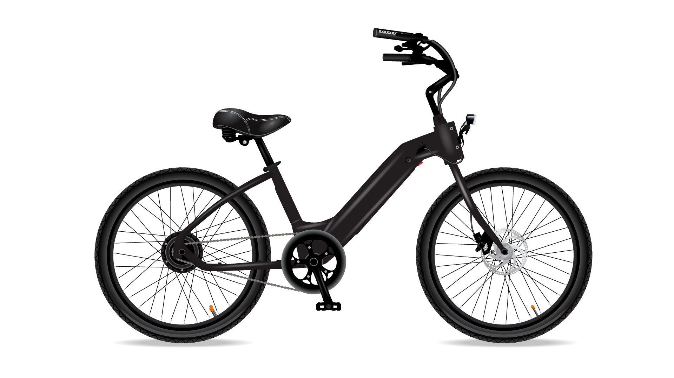
Cyclistic Bike-Share Case Study
Harjinder Singh
02/25/2023

Slide 2
About us
Cyclistic: A bike-share program in Chicago that features more than 5,800 bicycles and 600 docking stations.
Cyclistic sets itself apart by also offering:
reclining bikes
hand tricycles
cargo bikes

Slide 3
Key Stakeholders
Lily Moreno: The director of marketing.
Cyclistic marketing analytics team: A team of data analysts who are responsible for collecting, analyzing, and reporting data.
Cyclistic executive team: Executive team will decide whether to approve the recommended marketing program.

Slide 4
Business Task Objective
Market gap
Financials
Customers
How do annual members and casual riders use Cyclistic bikes differently?
Why would casual riders buy Cyclistic annual memberships?
How can Cyclistic use digital media to influence casual riders to become members?

Slide 5

Data Sources
Data Range
Previous 12 months of Cyclistic trip data.
February 2022 to January 2023.
Data Location
<https://divvy-tripdata.s3.amazonaws.com/index.html>
Data License Agreement
<https://ride.divvybikes.com/data-license-agreement>

Slide 6
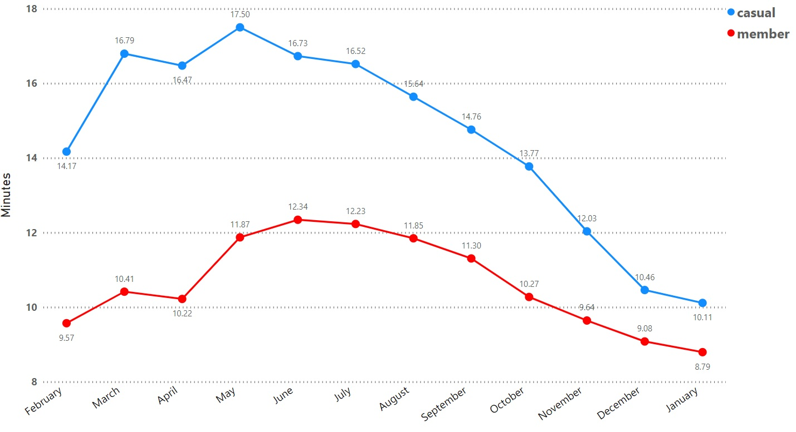
Average Ride Length Per Month
2022
2022
2023

Slide 7
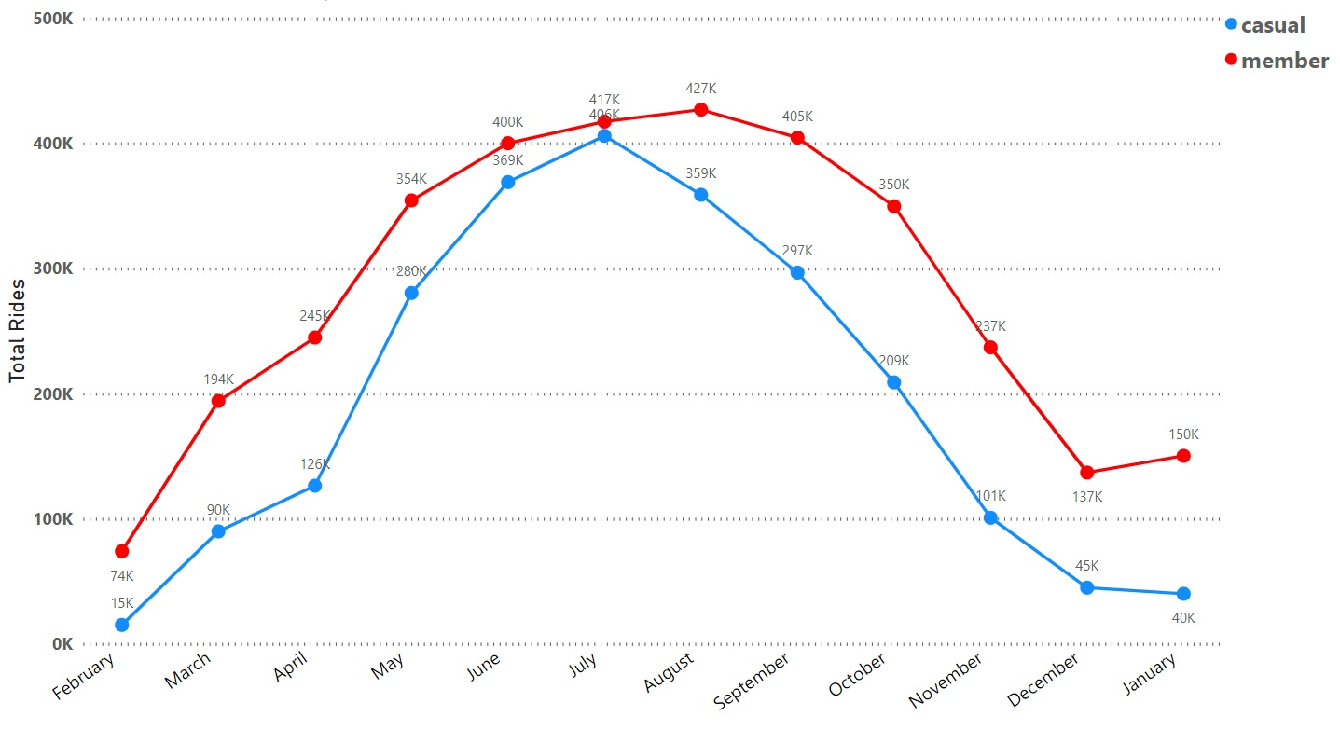
Total Rides Per Month by Member Type
2022
2022
2023

Slide 8
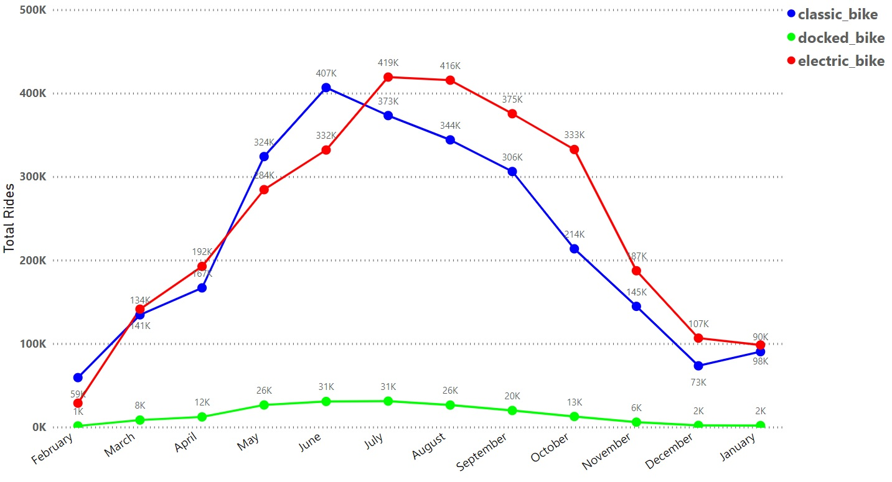
Total Rides Per Month by Type of Bike
2022
2022
2023

Slide 9
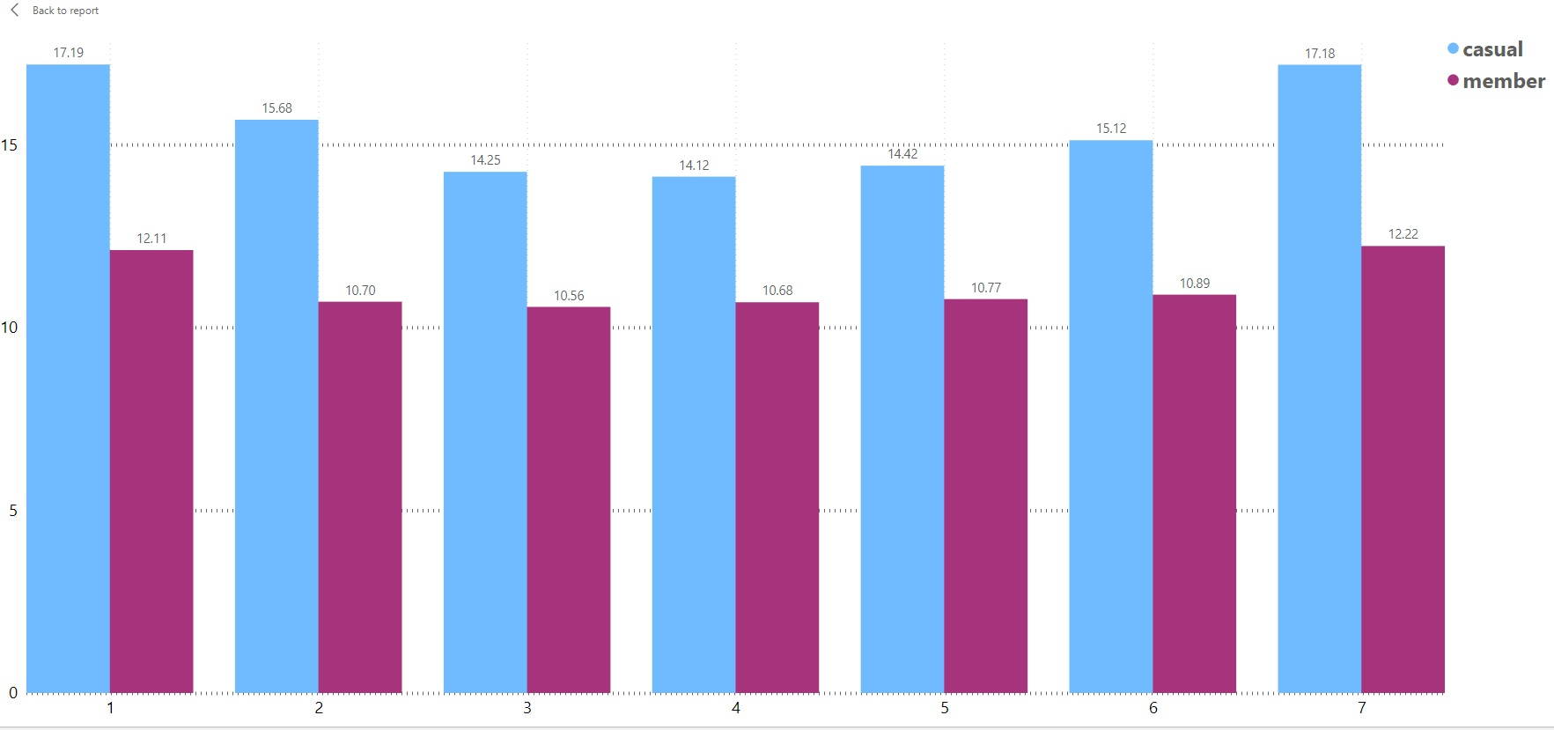
Average Ride Length Per Day
Sunday
Monday
Tuesday
Wednesday
Thursday
Friday
Saturday

Slide 10
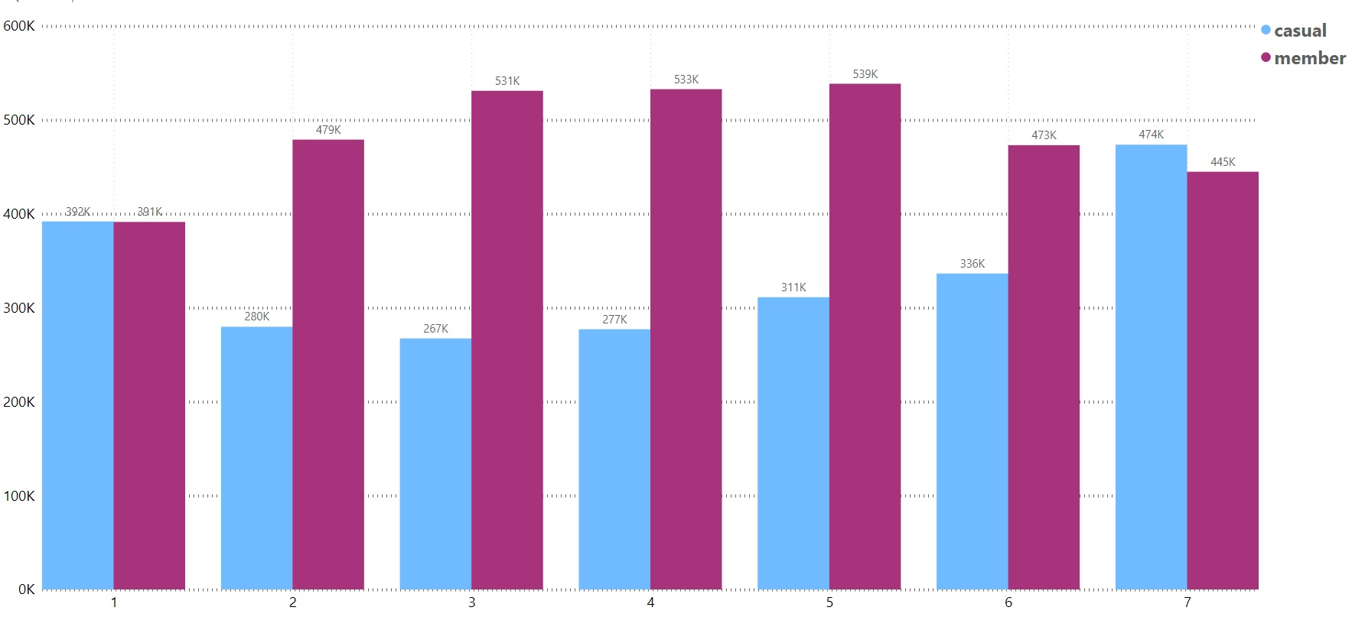
Total Rides Per Day
Sunday
Monday
Tuesday
Wednesday
Thursday
Friday
Saturday

Slide 11
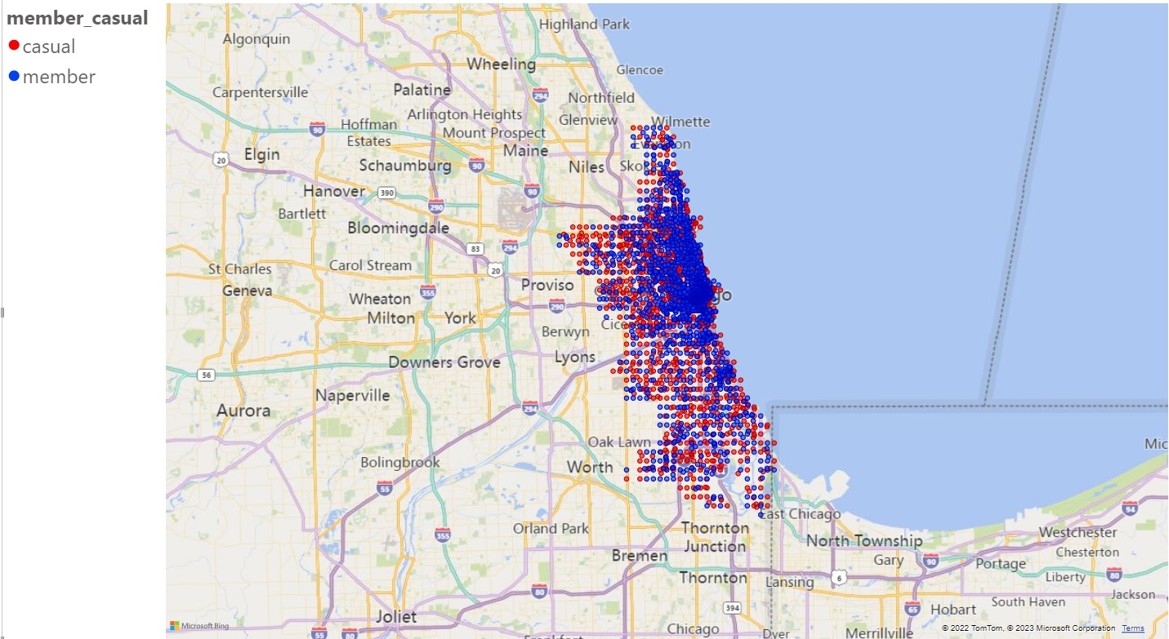
Geographical Data

Slide 12
Key Findings
Average Ride Length
Type of Bike
Monthly Rides by Member
Casual members ride longer than Annual members do on a daily and monthly basis.
Electrical and Classic Bikes are significantly more in demand than Docked Bikes.
Annual members ride more than Casual members do on a daily and monthly basis.

Slide 13

Summary
Data is inconclusive as to why casual members do not sign up for yearly membership.
Casual membership usership is lowest during the WEEKDAYS.
More research is needed to give recommendations to business plan.
Conduct survey to 385 Casual Members to get information about why they are hesitant to sign up for annual membership.

Slide 14

Survey
Pricing
Uses for e-bike
Location
Age
Days of Usage
Student/Professional
Weekend Usage
Demographics
14-day Trial Period

Slide 15
Action plan
Analyse Survey from February
Analyse Data from the last month to see if there are any change to membership
Gather feedback
2023
JAN
FEB
MAR
APR
MAY
JUN
JUL
AUG
SEP
OCT
NOV
DEC
Survey 385 Casual Members
Launch New Annual Memberships
Adjust pricing or marketing techniques to increase membership

Slide 16
Thank you
If you have any questions, feel free to reach out to me on my email listed below.
Harjinder Singh
singhharjinder11@yahoo.com

